Slide 1
Mass Changes
CCI – Mass Carrier Change Information
ROI – Mass Resp Org Change Information
MRO – Multi-Dial Number RO Change
MND - Multi-Dial Number Disconnect
MSP - Multi-Dial Number Spare
MNQ – Multi Number Query
MCP – Multi Number Conversion to Pointer
8. AJR - Automation Job Review
9. View Output Screen
SMS/800 ® is a registered trademark of SMS/800, Inc.
Notes:
There are 8 screens associated with Mass Changes. The first 2 involve sending in a form for the job to be scheduled and run. The other 6 are part of the Automation Features.
(Click)
1. CCI – Mass Carrier Change Information
(Click)
2. ROI – Mass Resp Org Change Information
(Click)
3. MRO – Multi-Dial Number RO Change
(Click)
4. MND - Multi-Dial Number Disconnect
(Click)
5. MSP - Multi-Dial Number Spare
(Click)
6. MNQ – Multi Number Query
(Click)
7. AJR - Automation Job Review
(Click)
8. View Output Screen
(Click)

Slide 2
SMS/800 Course Roadmap
15 Reporting
12 CRA
11 ROP
7 LAD
13 Automation
6 CPR
10 ASL
14 Carrier
3 Introduction
8 TAD
4 NUS
2 Benefits
1 Welcome
9 TRQ
5 CAD
16 WEB
Mon.
Tue.
Fri.
Wed.
Thu.
Here You Are
Notes:
(Click) This course is a 5 day course. Monday we will cover the Welcome
(Click) , Benefits
(Click) , Introduction
(Click) , NUS (Reserving numbers
(Click) , and CAD (Building customer records
(Click) . Tuesday we will build Complex Records using the CPR
(Click) . Wednesday we will add Label definitions (LAD) to our complex routing
(Click) . Thursday we will cover several feature screens: TRQ
(Click) , ASL
(Click) , ROP
(Click) , CRA
(Click) , AUTOMATION
(Click) AND CARRIER
(Click) . Friday We will learn how to use the WRS Reporting System
(Click) and review the SMS/800 business website
(Click) . Let us begin…

Slide 3
Mass Carrier Change
A Mass Carrier Change occurs when a Resp Org submits an order to change one CIC to another CIC on all Customer Records under their Resp Org ID.
(All or Nothing) All numbers under the Resp Org ID.
The SMS/800 Help Desk sets up the Mass Change. (Form 17 needs to be submitted)
Resp Org Users can access the CCI screen to view and print information concerning the CIC change.
Notes:
(Click)
A Mass Carrier Change occurs when a Resp Org submits an order to change one CIC to another CIC on all Customer Records under their Resp Org ID.
(Click)
(All or Nothing) All numbers under the Resp Org ID.
(Click)
The SMS/800 Help Desk sets up the Mass Change. (Form 17 needs to be submitted)
(Click)
Resp Org Users can access the CCI screen to view and print information concerning the CIC change.

Slide 4
CCI Screen
Set up by Help Desk – Change CIC on all numbers
Notes:
Here is the CCI screen.
(Click)
The fields include:
(Click)
MCC ID Mass Carrier Change ID
(Click)
Or the user can select from the existing list
(Click)
The Start date of the job as scheduled
(Click)
The end date of the job
(Click)
The RO, old CIC and New CIC

Slide 5
Mass Resp Org Change
A Mass Resp Org Change occurs when a Resp Org submits an order to change the Resp Org ID on all Customer Records under their Resp Org ID.
The SMS/800 Help Desk sets up the Mass Change. (Form 20)
Resp Org Users can access the ROI screen to view and print information concerning the mass change.
(There is a Partial Mass Resp Org Change job that can be done by sending in the request with a file to the Help Desk – not viewable from ROI)
Notes:
A Mass Resp Org Change occurs when a Resp Org submits an order to change the Resp Org ID on all Customer Records under their Resp Org ID.
(Click)
The SMS/800 Help Desk sets up the Mass Change. (Form 20)
(Click)
Resp Org Users can access the ROI screen to view and print information concerning the mass change.
(Click)
(There is a Partial Mass Resp Org Change job that can be done by sending in the request with a file to the Help Desk – not viewable from ROI)
(Click)

Slide 6
ROI Screen Help Desk Change of Resp Org Id on all numbers of Resp Org
Status = Pending or Active
Notes:
Here is the ROI screen. The Mass Resp Org Change Information screen
(Click)
The fields include:
(Click)
The Old Resp Org
(Click)
The NEW Resp Org and completion date
(Click)
The status of the job
(Click)
Status can be Pending or Active

Slide 7
MRO (Multi-Dial Number Resp Org Change)
The screen allows authorized users to change the Resp Org on an entire set of Dial Numbers at the same time in one single request (Up to 500 numbers). The Numbers to be changed can be typed or pasted into the Dial Numbers field. Users can also import the numbers from a “.TXT” file. (Logon ID of requester will show in WRS History)
The users will be able to change the Resp Org ID on numbers in Assigned, Disconnect, Reserved, Suspend, Transitional, and Working Status through this MRO screen.
This function will change the Resp Org in place and no copy of the customer records will be performed for numbers which have customer records. Any CRs having a future Eff. Date/Time with a CR status of “Pending” will be changed to “Must Check”.
The MRO screen can be accessed via the Main Menu.
To be notified by Email when the Job is complete, fill out the Email address field. Email of New Resp Org will receive notification if on ORC.
Notes:
The MRO is the first Automation Screen that:
(Click)
The screen allows authorized users to change the Resp Org on an entire set of Dial Numbers at the same time in one single request (Up to 500 numbers). The Numbers to be changed can be typed or pasted into the Dial Numbers field. Users can also import the numbers from a “.TXT” file. (Logon ID of requester will show in WRS History)
(Click)
The users will be able to change the Resp Org ID on numbers in Assigned, Disconnect, Reserved, Suspend, Transitional, and Working Status through this MRO screen.
(Click)
This function will change the Resp Org in place and no copy of the customer records will be performed for numbers which have customer records. Any CRs having a future Eff. Date/Time with a CR status of “Pending” will be changed to “Must Check”.
(Click)
The MRO screen can be accessed via the Main Menu.
(Click)
To be notified by Email when the Job is complete, fill out the Email address field. Email of New Resp Org will receive notification if on ORC.
(Click)

Slide 8
MRO Screen Change RO on a limited list (up to 500 numbers)
800-444-5567
888-345-6789
877-224-1234
800-555-7890
BRSAC
Test
NEW RO@EMAIL.COM
Notes:
Here is the MRO screen.
(Click)
The 3 required fields of the MRO are the Dial Numbers
(Click)
New Resp Org
(Click)
Request Description
(Click)
The optional field is the email to be notified when the job is finished.

Slide 9
MND Multi-Dial Number Disconnect
The MND screen allows authorized users to Disconnect an entire set of Dial Numbers at the same time in one single request (Up to 500 numbers). The Numbers to be changed can be typed or pasted into the Dial Numbers field. Users can also import the numbers from a “.TXT” file.
The users will be able to Disconnect numbers in “Working” Status through this MND screen. (Any working numbers with an attached future record will be rejected. Delete any future records)
The MND screen can be accessed via the Main Menu.
Notes:
(Click)
The MND screen allows authorized users to Disconnect an entire set of Dial Numbers at the same time in one single request (Up to 500 numbers). The Numbers to be changed can be typed or pasted into the Dial Numbers field. Users can also import the numbers from a “.TXT” file.
(Click)
The users will be able to Disconnect numbers in “Working” Status through this MND screen. (Any working numbers with an attached future record will be rejected. Delete any future records)
(Click)
The MND screen can be accessed via the Main Menu.

Slide 10
MND Screen
Notes:
The fields of the MND screen include:
(Click)
The Dial Numbers:
(Click)
The Disconnect Details: Start Eff date/time, End Intercept and Referral
(Click)
Request Description
(Click)
Optional email address to be notified when the job is done.

Slide 11
MSP (Multi-Dial Number Spare)
The screen allows authorized users to SPARE an entire set of Dial Numbers at the same time in one single request (Up to 500 numbers). The Numbers to be changed can be typed or pasted into the Dial Numbers field. Users can also import the numbers from a “.TXT” file.
The users will be able to SPARE numbers in Reserved or Transitional Status through this MSP screen.
Notes:
(Click)
The screen allows authorized users to SPARE an entire set of Dial Numbers at the same time in one single request (Up to 500 numbers). The Numbers to be changed can be typed or pasted into the Dial Numbers field. Users can also import the numbers from a “.TXT” file.
(Click)
The users will be able to SPARE numbers in Reserved or Transitional Status through this MSP screen.

Slide 12
MSP Screen
Notes:
The MSP screen with the fields of
Dial Numbers
Request Description
And
Email address

Slide 13
MNQ (Multi-Dial Number Query)
Multi-Dial Number Query (MNQ) allows a Resp Org the capability to “Get Info” for a list of toll-free numbers (up to 500 dial numbers).
1. Type in the numbers, paste in the numbers, or select the Import button which will allow the user to select a file from their data files and place it in the Dial Numbers scroll area.
2. Enter the description for this request in the Request Description field
3. Optionally enter or select from the drop down list an email address in the Email address field to receive an Email notification when the request is completed.
4. Click on Submit
Notes:
1. Type in the numbers, paste in the numbers, or select the Import button which will allow the user to select a file from their data files and place it in the Dial Numbers scroll area.
2. Enter the description for this request in the Request Description field
3. Optionally enter or select from the drop down list an email address in the Email address field to receive an Email notification when the request is completed.
4. Click on Submit

Slide 14
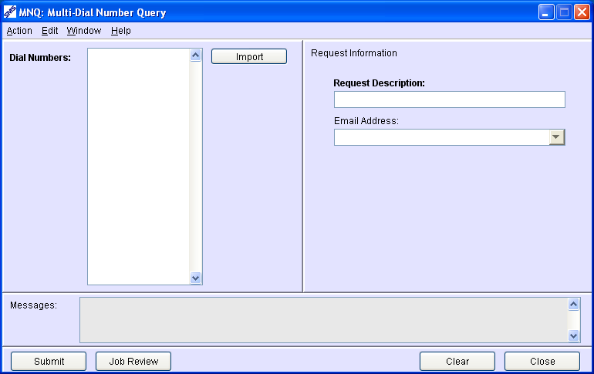
MNQ Screen
800flowers
866flowers
877flowers
Query1
Notes:
The MNQ screen with the fields of
Dial Numbers
Request Description
And
Email address

Slide 15
MCP (Multiple Conversion to Pointer Records)
The MCP (Multiple Conversion to Pointer Records) screen allows a Resp Org to convert a regular list of CAD records to PAD records(up to 5000 dial numbers).
1. Type in the numbers, paste in the numbers, or select the Import button which will allow the user to select a file from their data files and place it in the Dial Numbers scroll area.
2. Enter the Template Name and Effective date for conversion.
3. Enter the Request description.
4. Optionally enter or select from the drop down list an email address in the Email address field to receive an Email notification when the request is completed.
5. Click on Submit
Notes:
1. Type in the numbers, paste in the numbers, or select the Import button which will allow the user to select a file from their data files and place it in the Dial Numbers scroll area.
2. Enter the description for this request in the Request Description field
3. Optionally enter or select from the drop down list an email address in the Email address field to receive an Email notification when the request is completed.
4. Click on Submit

Slide 16
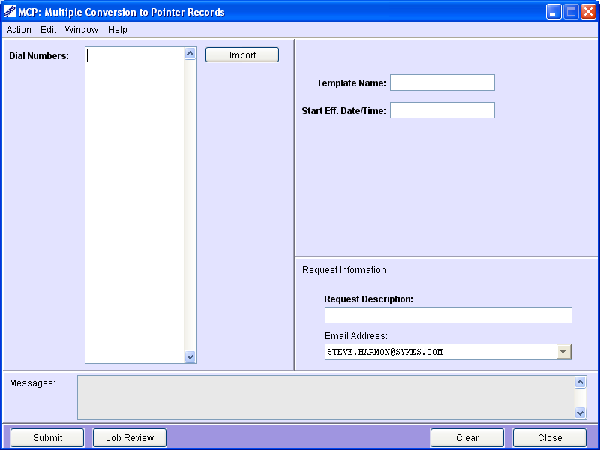
MCP Screen
800flowers
866flowers
877flowers
*BRtemp
11/11/11 11:00a/c
Conversion 1
Notes:
The MNQ screen with the fields of
Dial Numbers
Request Description
And
Email address

Slide 17
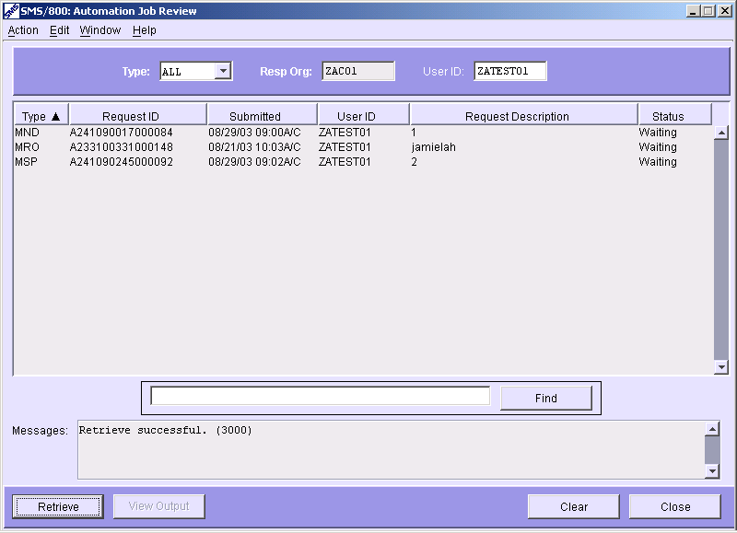
AJR (Automation Job Review)
The AJR screen enables users to view the status of jobs run within their own Resp Org and/or for their own User ID. They can bring this screen up via the Main Menu or from the Automation screens (MRO, MSP, MND, MCP or MNQ) that created the jobs. To view jobs for entire RO delete the User ID from the field. To see the detailed results select View Output.
User ID
Status –Waiting, In Progress, or Completed
View Output
Notes:
The Automation Job Review screen
(Click)
enables users to view the status of jobs run within their own Resp Org and/or for their own User ID.
(Click)
Jobs can display status of Waiting, In Progress or Completed
They can bring this screen up via the Main Menu or from the Automation screens (MRO, MSP, MND) that create the jobs.
(Click)
To view jobs for entire RO delete the User ID from the field
(Click)
To view the details of the job once ‘completed’, by selecting ‘View Output’ button

Slide 18
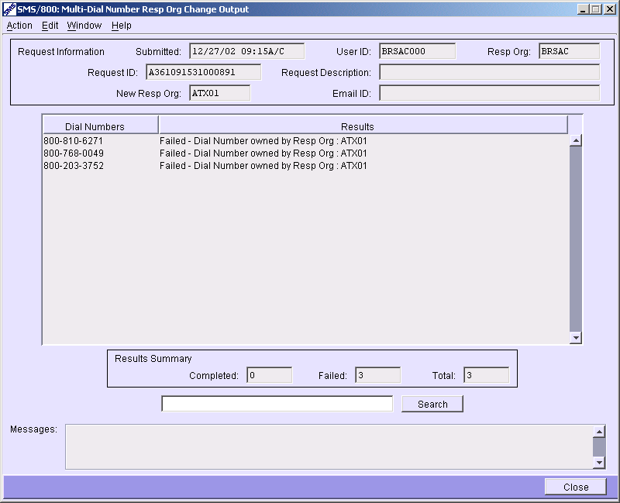
MRO (View Output)
The View Output screen enables users to view details of jobs run within their own Resp Org and/or for their own User ID. They can ONLY bring this screen up by pressing the “VIEW OUTPUT” button at bottom of AJR for MRO, MSP, MCP, MNQ and MND or double clicking a completed job listed in the AJR.
Results by Dial# = Failed or Completed
Notes:
The View Output screen enables users to view details of jobs run within their own Resp Org and/or for their own User ID.
(Click)
They can ONLY bring this screen up by pressing the button at bottom of AJR for MRO, MSP and MND or double clicking a completed job listed in the AJR.
(Click)
The results display each Dial# as Failed (did not change the number) or Completed.

Slide 19
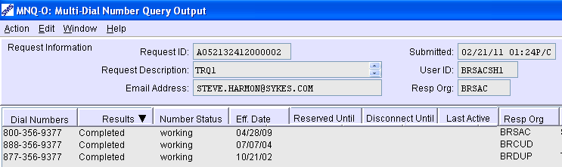
MNQ (View Output)
The MNQ View Output screen enables users to view the following information about any toll Free number in the SMS/800 database :
Number Status - One of the 8 NA statuses
Effective Date – The Date set for Activation on Customer Records.
Reserved Until – When a Reserved number will be returned to Spare.
Disconnect Until – End intercept date of a Disco number.
Last Active – Date of Spare or Reserved if/when number was last Active.
Resp Org ID – Resp Org who manages this number
Notes:
(Click)
The MNQ View Output screen enables users to view details of MNQ jobs run within their own Resp Org and/or for their own User ID.
(Click)
Number Status - One of the 8 NA statuses
(Click) (Click)
Effective Date – The Date set for Activation on Customer Records.
(Click) (Click)
Reserved Until – On a Reserved number, when the number will be returned to Spare.
(Click) (Click)
Disconnect Until – End Intercept date of a Disco number
(Click) (Click)
Last Active – Date if/when number was last Active
(Click) (Click)
Resp Org ID – Resp Org ID who manages this number
(Click)

Slide 20
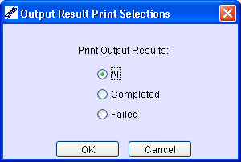
Print MRO (View Output)
The Print screen is available from the Action menu. A user can choose to print only the Failed or the completed or the whole list. Select Action/Print.
Notes:
The Print screen is available from the Action menu. Select Action/Print.
(Click)
A user can choose to print All, the completed or just the Failed.
(Click)

Slide 21
View Output for One Number
Run the Job (MRO, MND, MSP, MNQ, MCP) for one or more numbers.
Access the AJR screen to see if and/or when the Job is completed.
When the Job shows completed on the AJR, highlight it and select the VIEW OUTPUT at the bottom of the AJR to see if that specific number was changed (completed) or if it was not (failed).
Notes:
To View output for a single number in a Job…
(Click)
Run the Job (MRO, MND, MSP) for one or more numbers.
(Click)
Access the AJR screen to see if and/or when the Job is completed.
(Click)
When the Job shows completed on the AJR, select the VIEW OUTPUT at the bottom of the AJR to see if that specific number was changed (completed) or if it was not (failed).

Slide 22
Mass Changes – Review
CCI – Mass Carrier Change Information
ROI – Mass Resp Org Change Information
MRO – Multi-Dial Number RO Change
MND - Multi-Dial Number Disconnect
MSP - Multi-Dial Number Spare
MNQ – Multi Number Query
MCP – Multi Number conversion to Template
8. AJR - Automation Job Review
9. View Output Screen
Written Exercise Mass Changes # 12
Hands On Exercise #12A-B
Notes:
Please complete the Written and Hands On exercises.

